Slide 1
Advanced Computer Graphics Real Time Graphics Techniques
Erik Sintorn – erik.sintorn@chalmers.se

Slide 2
Deferred Shading

Slide 3
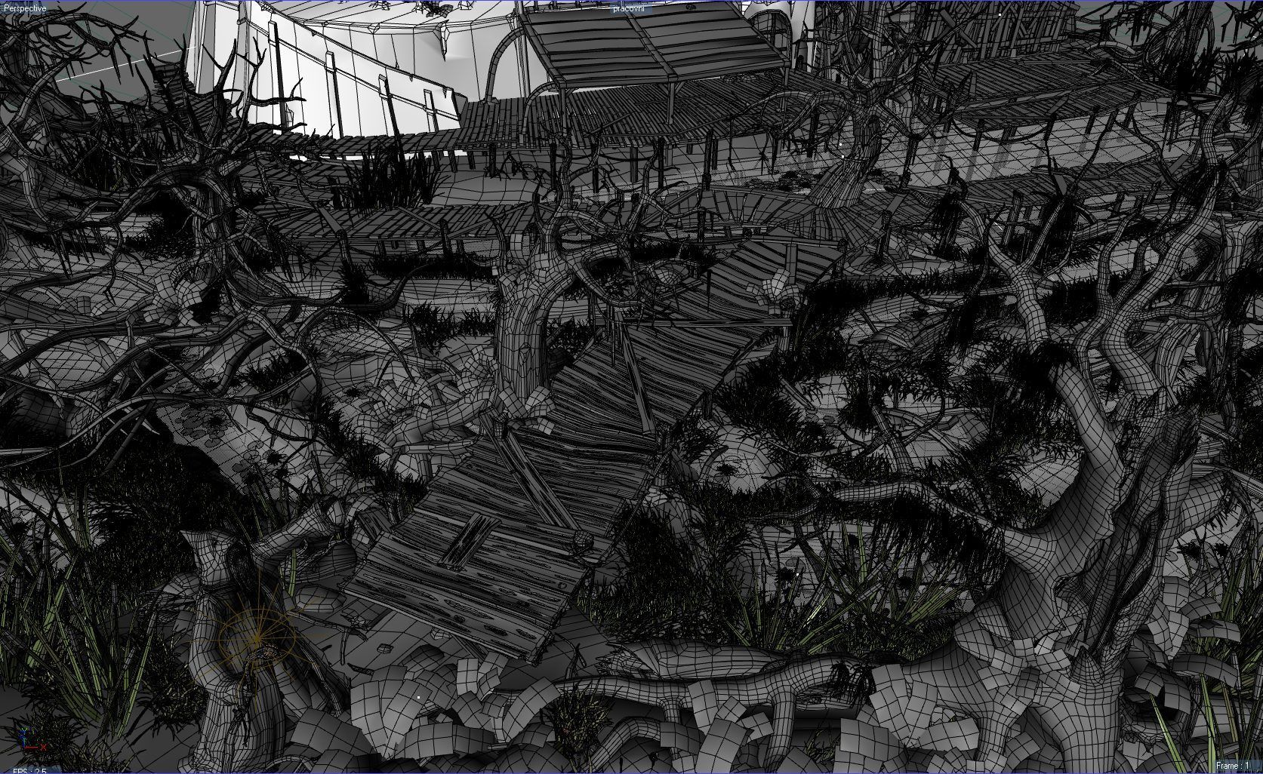
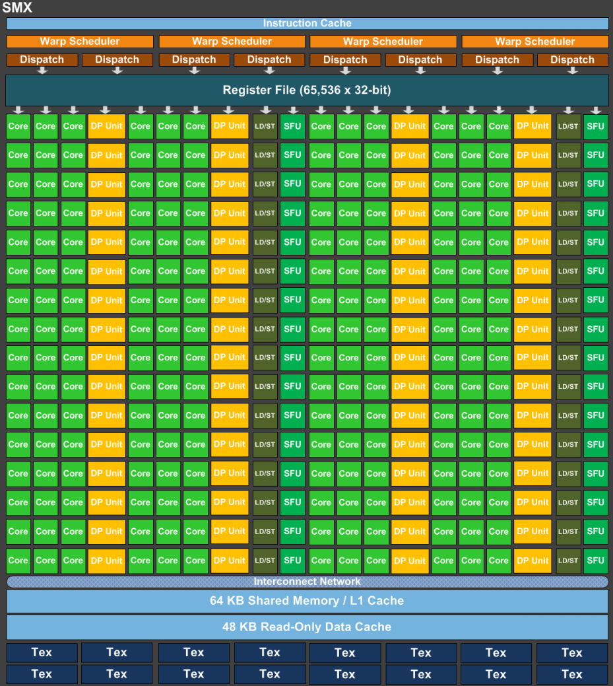
Deferred Shading
Primitive Assembly
Pixel Coordinate Integer Snapped vertices
Vertex Indices and Vertices
Triangle Setup
Device Memory
Input Assembly
Edge equations, etc…
vertex cache
Rasterizer
Hi-z
32 input vertices
32 frags
Early Z
Z Culling:
Early and Hi-z help cull fragments before they are shaded
Still, Z Culling can only help if an occluded fragment is drawn after the occluding fragment
Multi Processor
Multi Processor
Multi Processor
Multi Processor
32 shaded vertices
Z-culling
32 shaded fragments
Blending
non culled fragments
Notes:
This is the pipeline as we talked about in last weeks lecture.
In many standard workloads, the absolute majority of work (and the bottle neck) is running the fragment shaders.

Slide 4
Deferred Shading
Deferred shading is one solution.
First introduced at SIGGRAPH 1988 (!)
Possible to implement on modern GPUs with the 6800 (2004)
Multiple render targets
Floating point (esp. 16bit) rendertargets.

Slide 5
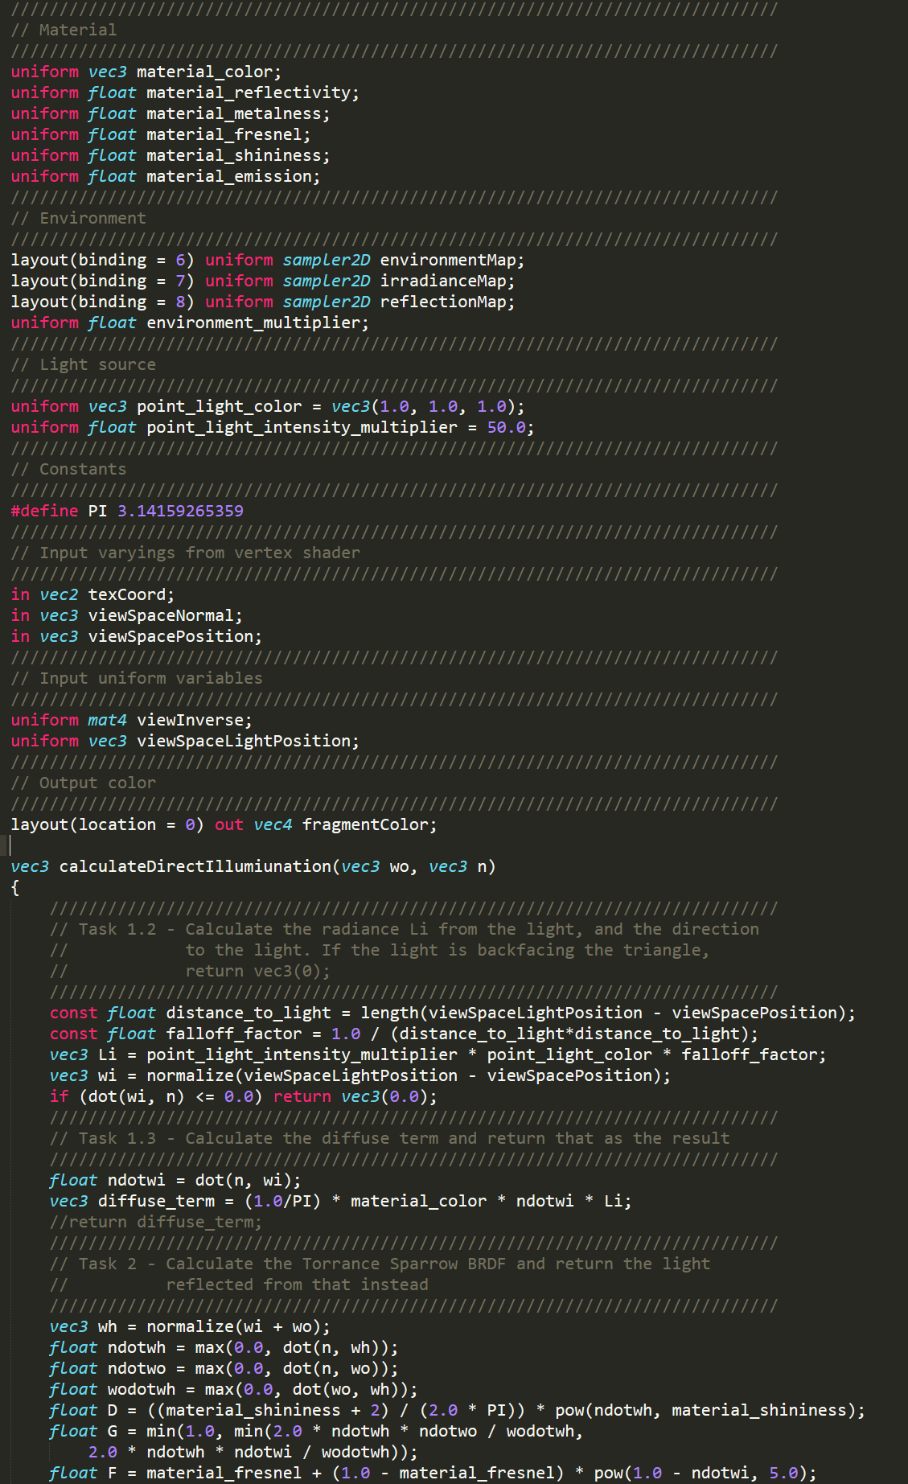
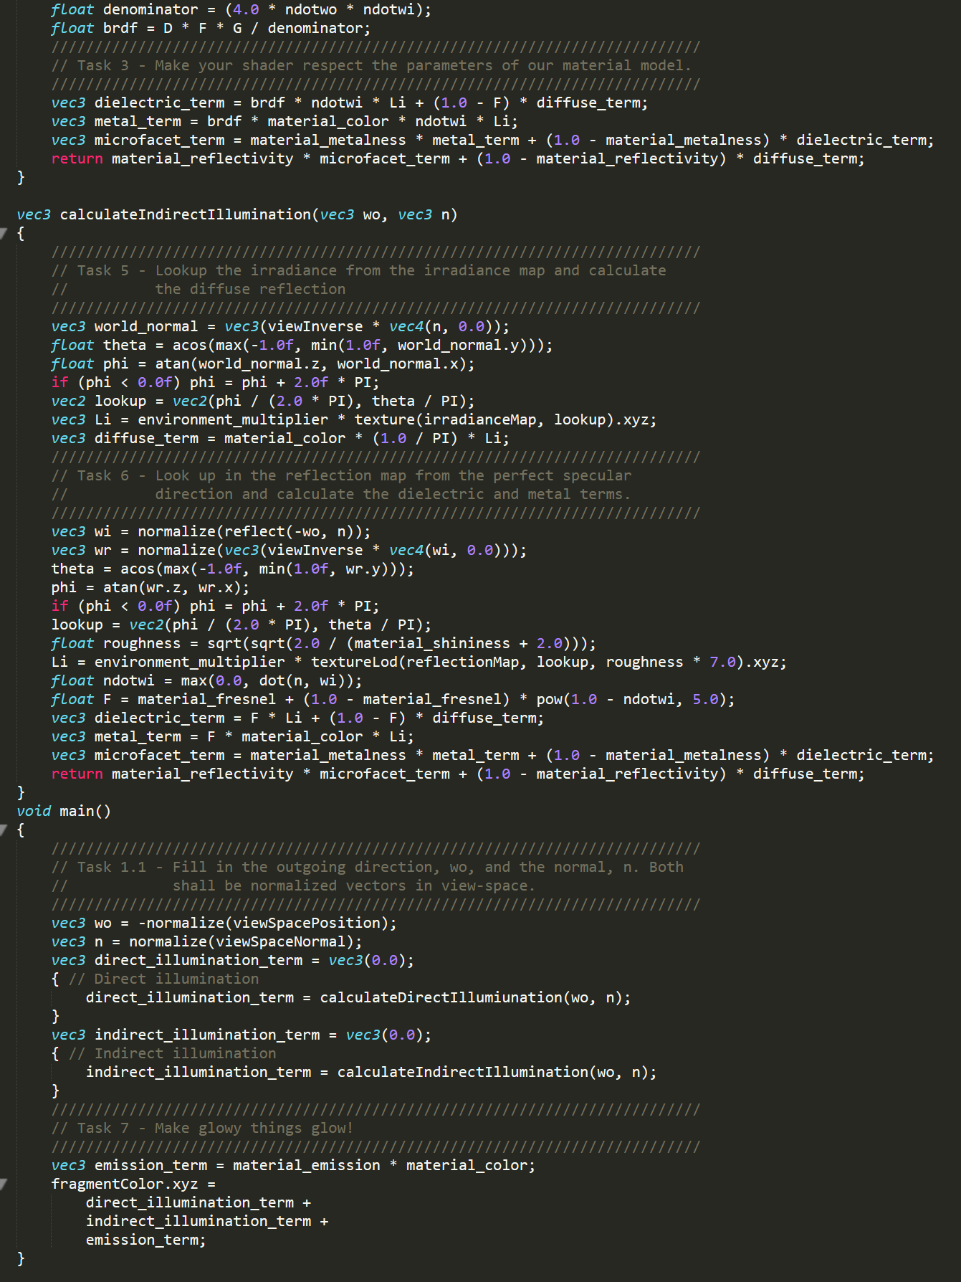
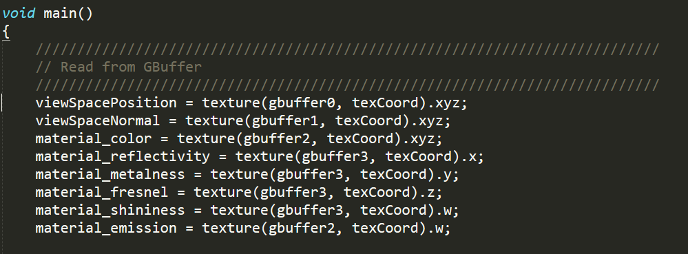
Deferred Shading
1st Pass: Render geometry to GBuffer.
In Vertex Shader, transform and project as usual.
In Fragment Shader, instead of calculating color, write down interpolated normal, material roughness, fresnel, color etc.
Not position, can calculate that from zbuffer and MVP
Will need at least two rendertargets.
Fragment shader is very cheap.
2nd Pass: Shading
Set up lights and shadow-maps, etc.
Bind the rendertargets from 1st pass as textures.
Render a single full-screen quad
In Fragment Shader, read the position, normal and material properties for this pixel, and shade for all lights.
depth
normal
material properties
Run once per fragment
Run once per pixel

Slide 6
Deferred Shading
Can significantly reduce rendering times
But the first pass is not cheap, as it requires high bandwidth.
And if the objects require different kinds of materials, all possible input data must be written to Gbuffer
Cannot handle transparent objects (easily) since only one fragment is saved per pixel
Antialiasing is problematic
Alternative: Z-Prepass
Render geometry once, only to depth buffer.
No fragment shader
Render geometry again, early-z will cull all fragments before shader.
Two geometry passes, expensive if very much geometry.

Slide 7
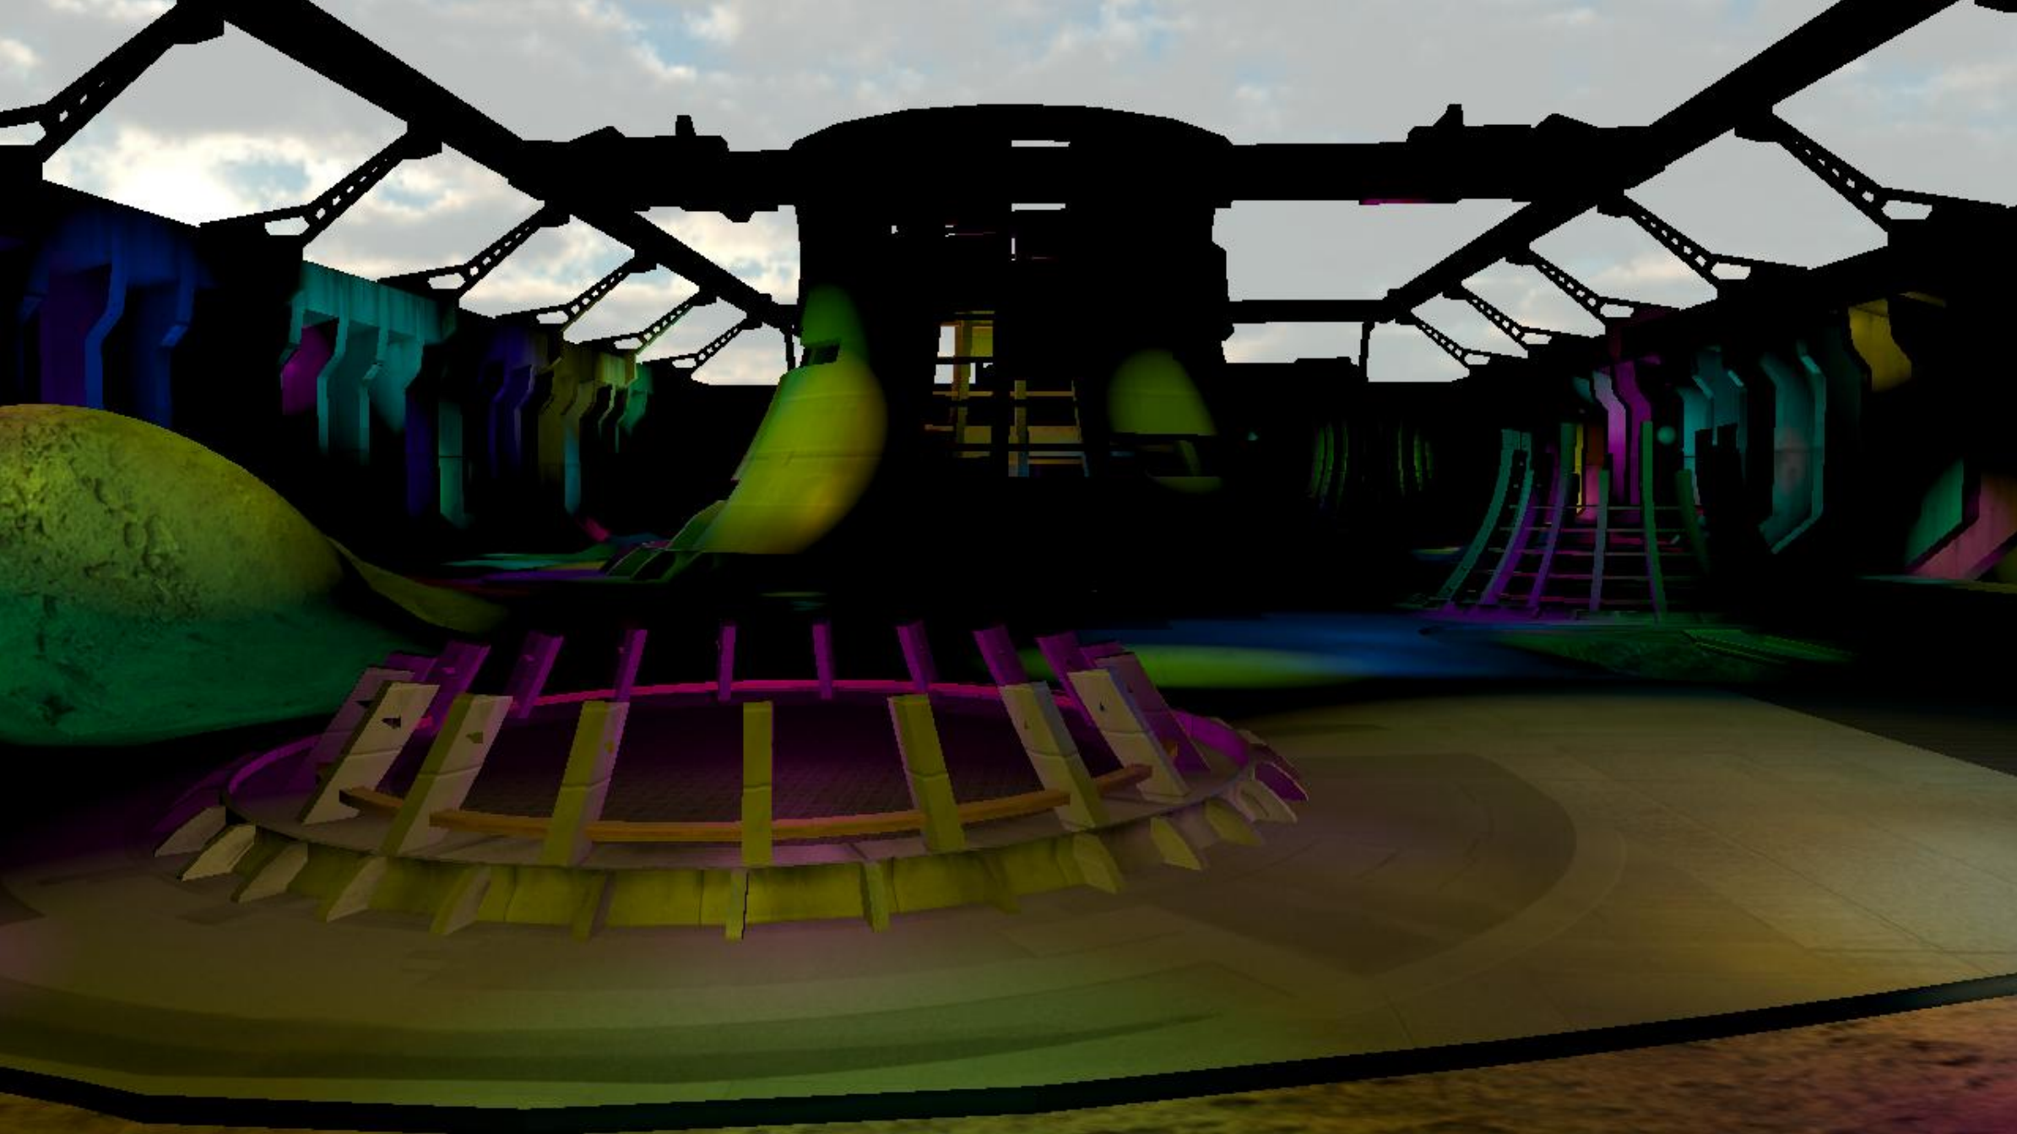
Deferred Shading With “small” lights
In games, some lights are often given a finite range
Can be very expensive to loop through 100 lights to find that only three of them affect fragment.
With deferred shading:
1st pass: Render Gbuffer as before
2nd pass: Instead of full-screen quad, render geometry for lights influence region and shade for generated fragments
Only shade for the current light.
Can significantly reduce complexity
But if lights overlap, the Gbuffer has to be read many times (example)
And each lights contribution is added by blending onto framebuffer
Draw quad at min-z of influence region, so fragments will be culled by zbuffer
To reduce overdraw, can draw the front faces of a low-poly sphere instead

Slide 8
Tiled Deferred Shading
There Will Be Overdraw
For a pixel affected by N lights, we need to read Gbuffer N times
Instead of once, and loop over lights
Tiled Deferred Shading reduces bandwidth problems:
Screen is divided into tiles and lights are assigned by, e.g., tiny SW rasterizer.
In 2nd pass, draw fullscreen quad again, but for each pixel shade only for the lights in the tile’s list.
Gbuffer is read only once per pixel
Lights contributions are accumulated in registers.

Slide 9
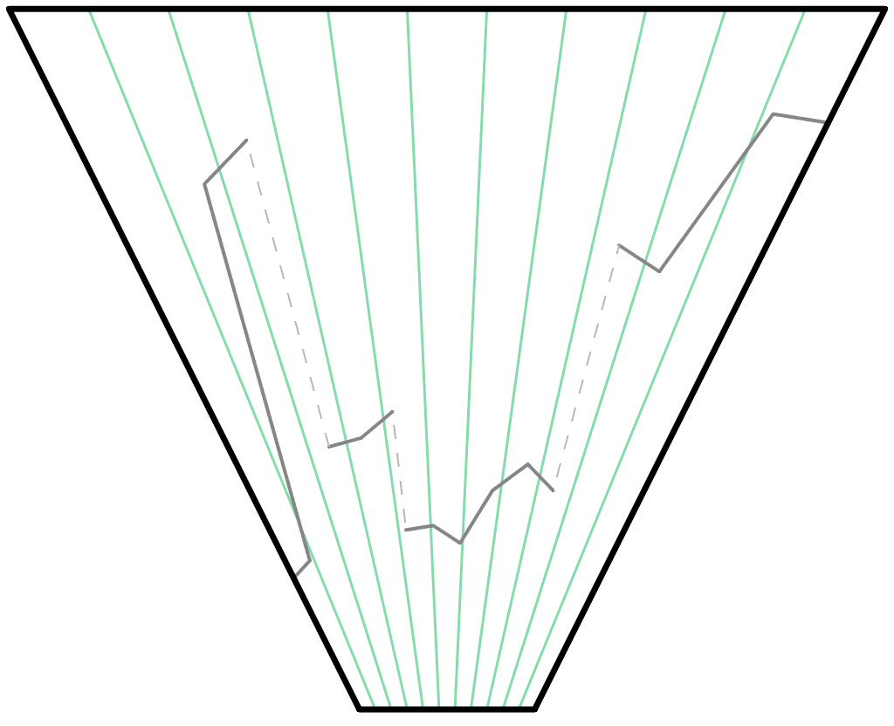
Tiled Shading
Tile X:
Notes:
There is one more clever trick to tiled shading

Slide 10
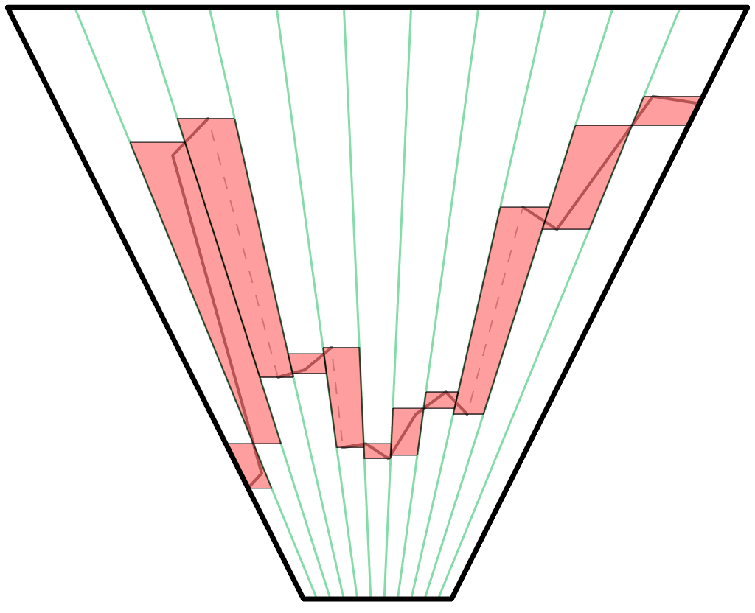
Tiled Shading
Tile X:
Notes:
There is one more clever trick to tiled shading

Slide 11
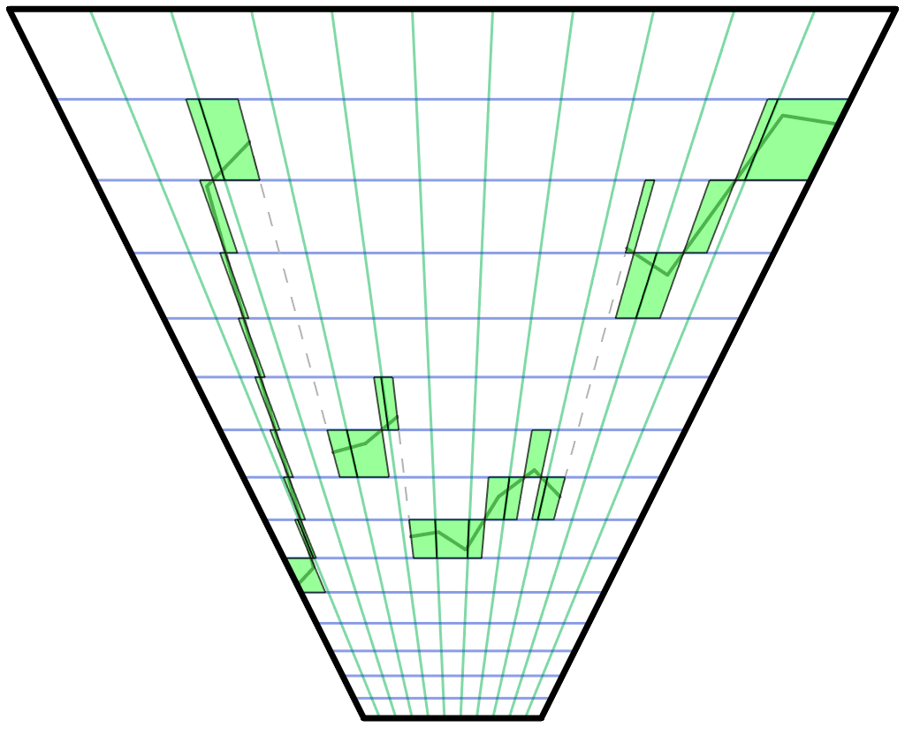
Clustered Shading
Tile X:
Notes:
There is one more clever trick to tiled shading

Slide 12
Tiled and Clustered forward shading
Light lists from tiled and clustered can just as well be used in a forward renderer.
Z prepass to build clusters/tiles anyways
Transparency and AA is easy again.

Slide 13
Cascaded Shadow Maps

Slide 14
Recap: Shadow Maps

Slide 15
Recap: Shadow Maps
If(sample depth < shadow-map depth)
sample is lit
Else
sample is in shadow
sample depth
shadow-map depth

Slide 16
Shadow Maps
light frustum
512 texels
8192x8192 texels => 256MB for one shadow map!!
512 pixels
view frustum
Notes:
Therefore, hard shadows are usually computed using some real-time method instead. Usually, some variant of the shadow mapping algorithm.
To avoid undersampling the shadow maps, we must have at least as many shadow map samples as we have pixels covering a small surface. So, a surface that covers, say, 512 pixels on screen must cover an equal amount of texels in the shadow map. If this surface only projects to a small part of the shadow map, as in this example, the entire shadow-map will have to be huge.

Slide 17
Shadow Maps
Even if we could afford the memory, having much more than 1 SM sample / pixel is not good
SM lookups would be very scattered!
light frustum
1024 texels
1024 texels
1024 texels
8 pixels
512 pixels
1024 pixels
view frustum
Notes:
Therefore, hard shadows are usually computed using some real-time method instead. Usually, some variant of the shadow mapping algorithm.
To avoid undersampling the shadow maps, we must have at least as many shadow map samples as we have pixels covering a small surface. So, a surface that covers, say, 512 pixels on screen must cover an equal amount of texels in the shadow map. If this surface only projects to a small part of the shadow map, as in this example, the entire shadow-map will have to be huge.

Slide 18
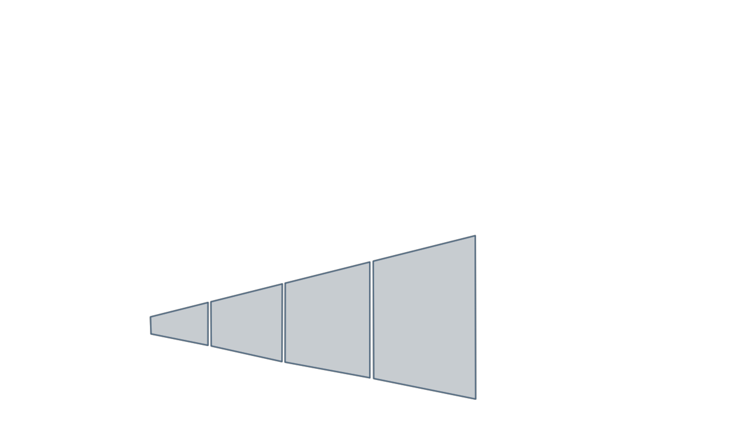
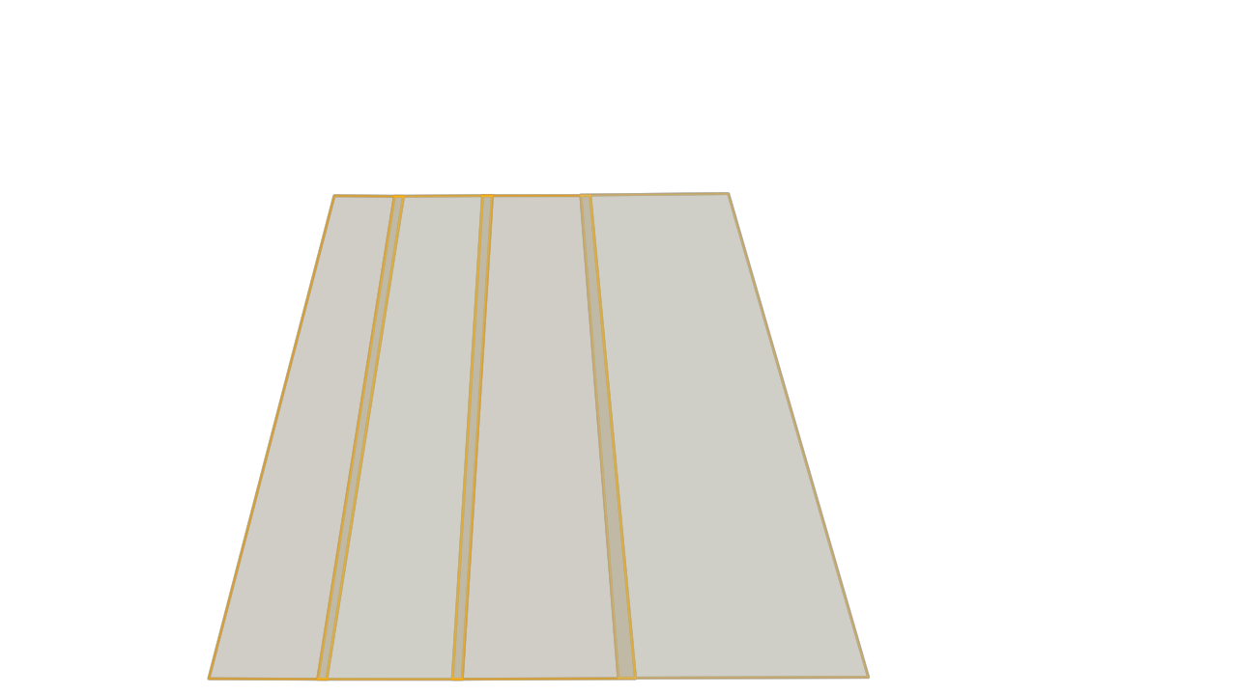
Cascaded Shadow Maps
shadow map 0
shadow map 1
shadow map 2
shadow map 3
512 texels
512 pixels
cascade 0
cascade 1
cascade 2
view frustum
cascade 3
Notes:
This problem is commonly alleviated using a technique called cascaded shadow maps. Here <click> the view-frustum is split in to several parts (or cascades).
<click>
And then, a shadow map is rendered for each of these cascades.
<click>
Now, the surface covers approximately as many samples on screen as it does in the shadow map of the first cascade, and all is well.
One problem is avoiding visible transitions between shadow cascades.
Another obvious drawback is that we now have to render several shadow maps each frame, which will significantly impact performance. Especially as we have to re-render all geometry, not just dynamic objects.
Note that there can be significant overlap between the shadow-maps, and that we might end up submitting the same geometry to every shadow-map.

Slide 19
Show them DX sample:
https://github.com/walbourn/directx-sdk-samples
Set PCF 0, 1 Layer, Offset:0, Pancacing, MAP, 1024
Show from a distance: ok (ish)
Zoom in: Bad!
4096: Still not enough
Visualize cascades
10/20/40/80
View from above
Turn off visualize and show visible transitions
Set PCF 9, show transitions even worse
Explain cascade blending, show result
Set up nice shadows:
8 cascades
1,2,4,8,16,…
1024x1024
PCF 13
Justs one problem: FPS
Show PCF=1 => PCF fine

Slide 20
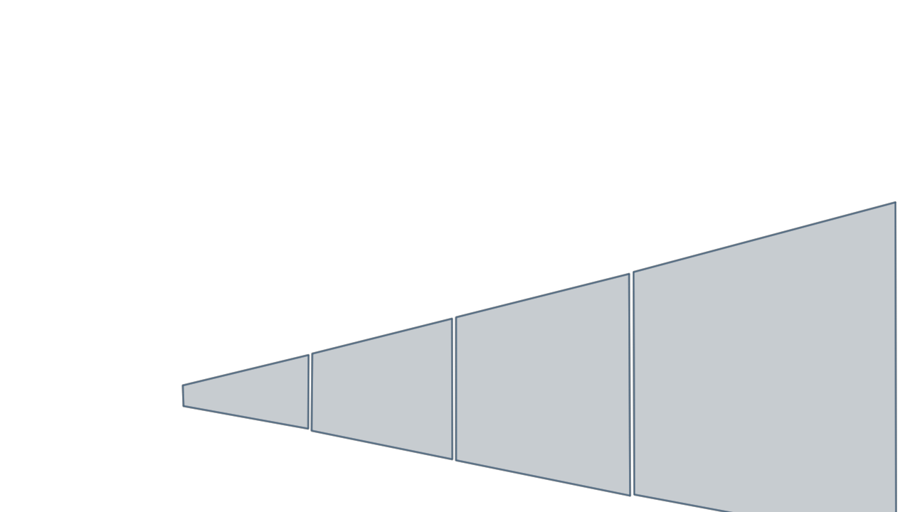
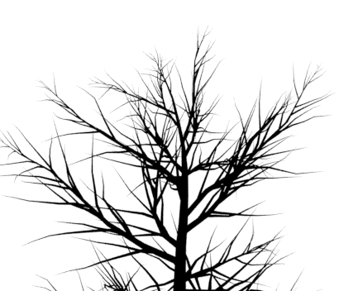
Cascaded Shadow Maps
shadow map 3
8x8 texels
8x8 pixels
cascade 0
cascade 1
cascade 2
cascade 3
Notes:
But we also run into the problem of initial sampling aliasing. Let’s say that there is a tree way of in the background.
<click>
Using Cascaded Shadow Maps, we have made sure that this area is covered by just a few texels, since it only covers a few pixels.
<click>
Unfortunately, this resolution is much too small to capture the complex geometry, and we will see serious aliasing artifacts in distant shadows.

Slide 21
Variance Shadow Maps

Slide 22
Shadow Filtering
What’s hard about shadow filtering?
We have lots of fancy hardware for filtering…
Unlike (most) texture maps,
We cannot interpolate between values for magnification!
We cannot average (mipmap) values for minification!
shadow map
shadow map
Magnification: Interpolating z-values does not give transition from light to shadow; Artificially interpolates where the shadow-caster is.
Minification: Averaging shadow values also only gives an average shadow-caster depth.

Slide 23
Variance Shadow Maps
Standard solution is to sample shadow for different samples in a filter, and average: PCF
Expensive. 9x9 taps is 81 texture lookups.
Variance Shadow Maps (VSMs, 2006) is an attempt at solving this
Reportedly used by several real game engines
Gives smooth shadows for large kernels very quickly
Doesn’t really work ☺, but apparently well enough for some cases.

Slide 24
Variance Shadow Maps
Mean of depths in filter is: $μ= \frac{1}{N}\sum{z_{i}}$
Variance is $σ^{2}= \frac{1}{N}\sum{z_{i}^{2}}−μ$
$μ$ and $\frac{1}{N}\sum{z_{i}^{2}}$ can both be interpolated and mipmapped, no problem.
Just write $z^{2}$ as to a color target while rendering shadow map
VSM:
Fetch filtered $μ$ and $σ^{2}$ from textures
Ignore individual samples and say that within the filter we have depth samples distributed with this mean and variance.
filter kernel
shadow map

Slide 25
Variance Shadow Maps
VSM:
Fetch filtered $μ$ and $σ^{2}$ from textures
Ignore individual samples and say that within the filter we have depth samples distributed with this mean and variance.
We want to know: “What fraction of the samples has depth x > t”
Chebychev’s inequality: $P\left(x≥t\right)≤\frac{σ^{2}}{σ^{2}+{\left(t −μ\right)}^{2}}$
For a single planar occlude this is an equality, so…
For a very small filter size it should be a good approximation, so…
Let’s use it for large filter sizes and hope that it works! ☺
filter kernel
shadow map

Slide 26
Variance Shadow Mapping
Show VSM demo
Extremely fast, extremely smooth shadows!
Weird light leakage when more than one shadow caster in filter region.
Might be your only option, but use with care…

Slide 27
Screen Space Reflections

Slide 28
Screen Space Reflections
Glossy reflections are vital for realistic materials
The proper solution is raytracing, and not feasible in games
Optimistic back-of-an-envelope calculation:
Let’s say we can trace one ray per pixel @ 1080p in 10ms
Need 256 rays for reasonable single bounce result
~2.5 sec per frame, and need to be at ~3ms
Need 853x faster GPUs
Assuming 2x faster every two years
True now, impossible to say if it holds
log2(853)*2=19.47 years
Your kids might not have to cheat much (but mine will)!

Slide 29
Screen Space Reflections
Current solutions:
Precomputed environment map
As in labs, very cheap
Only get reflections from infinitely far away
Realtime environment maps per object
Reasonable for e.g. main character
No self-reflections
Precomputed environment probes
Artist places probes and with radius that approximates distance to reflecting surfaces
For each fragment: Find closest probes and attempt to calculate local reflection
Only reflections from static geometry
Need many probes => much memory
Voxel Cone Tracing
Voxelize scene every frame and ray march reflections
Still a bit expensive (compute and memory)
Successfully used in some titles though
Screen Space Raytracing
Great results when it works!
Cheap (ish), ~3ms is a number from Ghost.
Need fallback

Slide 30
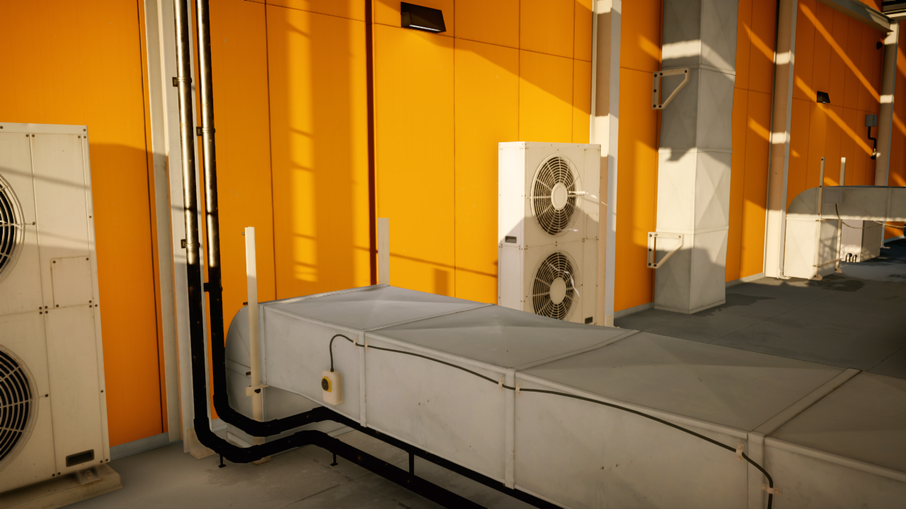
Screen Space Reflections
In shading pass, for each pixel:
Calculate reflection vector
Raymarch in the zbuffer
E.g., Bresenheim
Until we find an intersection
I.e., point on ray falls behind z-buffer
Check if zbuffer point is reasonably close to the point on ray
Return that color
Image © EA/Frostbite: http://www.frostbite.com/2015/08/stochastic-screen-space-reflections/

Slide 31
Screen Space Reflections (problems)
What if we march out of the image?
Nothing to do… return black

Slide 32
Screen Space Reflections (problems)
What if the object is behind the viewer?
Nothing to do… return black

Slide 33
Screen Space Reflections (problems)
What if the we can’t see the actual intersection point but it is in the frustum?
Nothing to do… return black

Slide 34
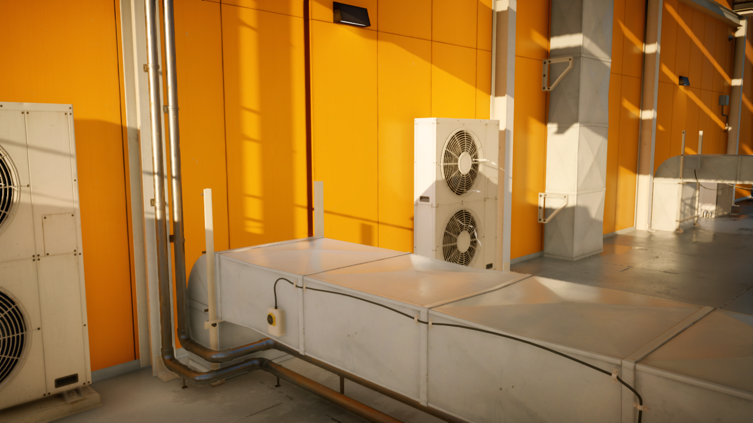
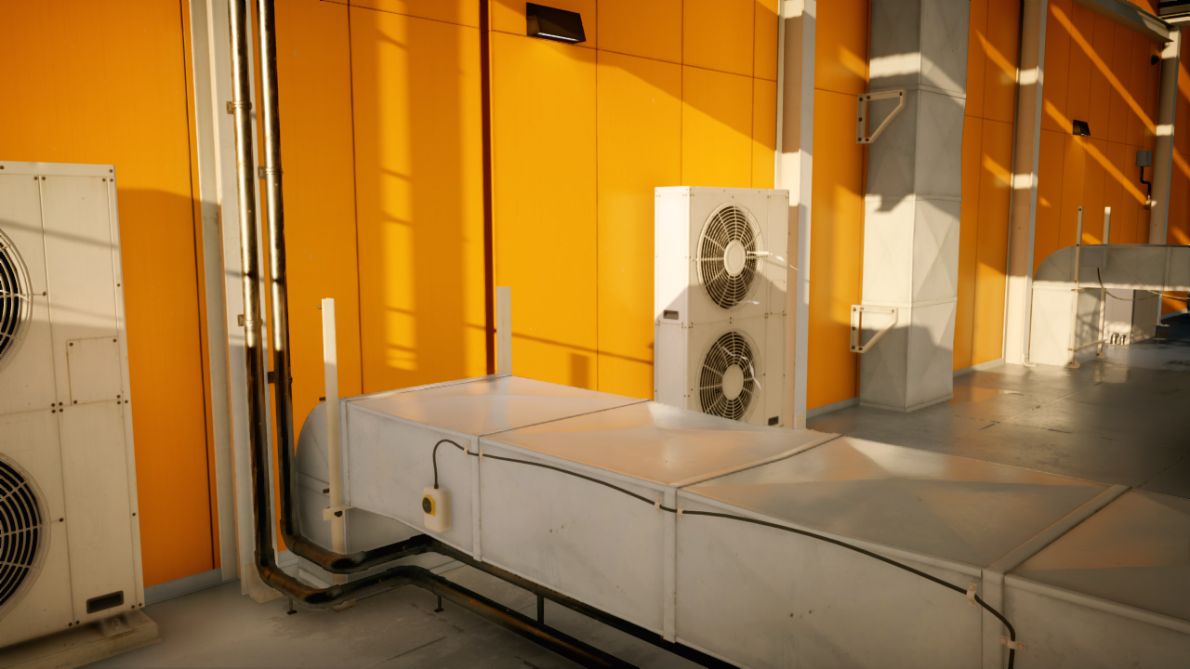
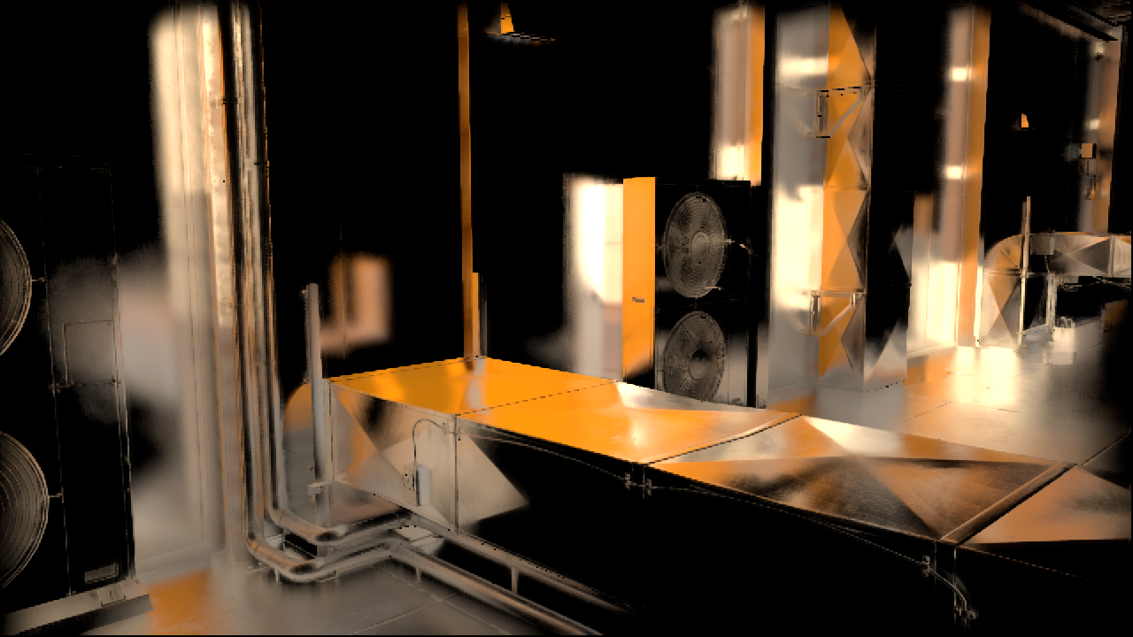
Screen Space Reflections
Still…
It works in many places
With only SSR result
Need a fallback
For example precomputed env-maps
Reflection falls
off-screen
Can’t see actual
intersection
Reflection is behind viewer
Image © EA/Frostbite: http://www.frostbite.com/2015/08/stochastic-screen-space-reflections/

Slide 35
Screen Space Reflections
Glossy reflections?
“Cone Tracing”
Preconvolve reflection image
Importance sample BRDF
Optimizations
Can create a min/max hierarchy of depth buffer, to improve tracing
Can reuse results between pixels
Temporal AA can reduce noise
Image © EA/Frostbite: http://www.frostbite.com/2015/08/stochastic-screen-space-reflections/

